Slide 1
Data Modeling Using the Entity-Relationship (ER) Model

Slide 2
Types of Attributes
Simple Attribute
Composite Attribute
Single-Valued Attribute
Multi-Valued Attribute
Derived Attribute
Complex Attribute
Stored Attribute
Key Attribute
Null Attribute
Descriptive Attribute

Slide 3
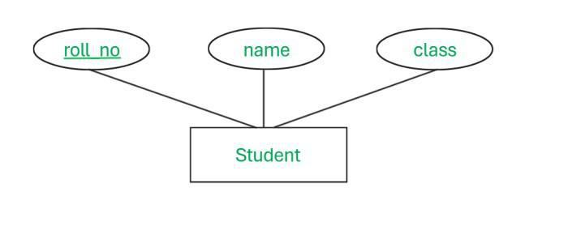
Simple Attribute
An attribute that cannot be further subdivided into components is a simple attribute.
Example: The roll number of a student, the ID number of an employee, gender, and many more.

Slide 4
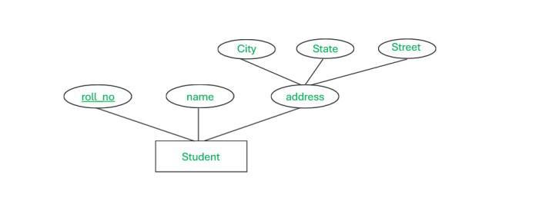
Composite Attribute
An attribute that can be split into components is a composite attribute.
Example: The address can be further split into house number, street number, city, state, country, and pin code, the name can also be split into first name middle name, and last name.

Slide 5
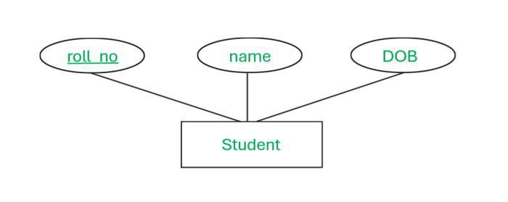
Single-Valued Attribute
The attribute which takes up only a single value for each entity instance is a single-valued attribute.
Example: The age of a student, Aadhar card number.

Slide 6
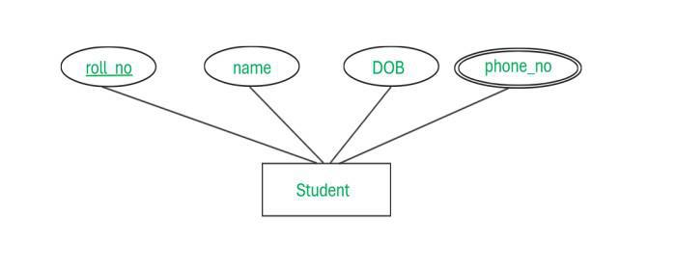
Multi-Valued Attribute
The attribute which takes up more than a single value for each entity instance is a multi-valued attribute. And it is represented by double oval shape.
Example: Phone number of a student: Landline and mobile.

Slide 7
Stored Attribute
The stored attribute are those attribute which doesn’t require any type of further update since they are stored in the database.
Example: DOB(Date of birth) is the stored attribute.

Slide 8
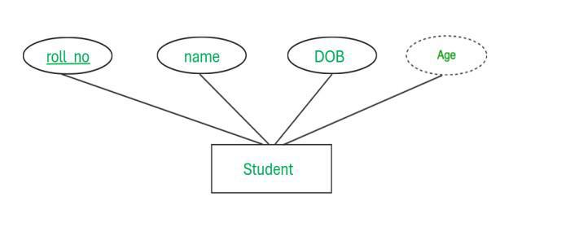
Derived Attribute
An attribute that can be derived from other attributes is derived attributes. And it is represented by dotted oval shape.
Example: Total and average marks of a student, age of an employee that is derived from date of birth.

Slide 9
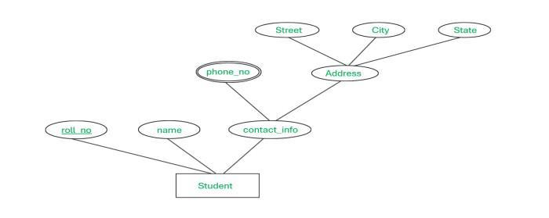
Complex Attribute
attributes, which can be formed by the nesting of composite and multi-valued attributes, are called “Complex Attributes“. Example: Address because address contain composite value like street, city, state, PIN code and also multivalued because one people has more that one house address.

Slide 10
Key attribute
Key attributes are those attributes that can uniquely identify the entity in the entity set.
Example: Roll-No is the key attribute because it can uniquely identify the student.
Null Attribute
This attribute can take NULL value when entity does not have value for it.
Example –The ‘Net Banking Active Bin’ attribute gives weather particular customer having net banking facility activated or not activated.
For bank which does not offer facility of net banking in customer table ‘Net Banking Active Bin’ attribute is always null till Net banking facility is not activated as this attribute indicates Bank offers net banking facility or does not offers.

Slide 11
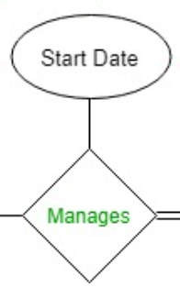
Descriptive Attribute
Descriptive attribute give information about the relationship set example given below. Here Start Date is the descriptive attribute of Manages relationship.

Slide 12
Strong entity
Strong Entity is independent of any other entity in the schema
Example – A student entity can exist without needing any other entity in the schema or a course entity can exist without needing any other entity in the schema.
A Strong entity is nothing but an entity set having a primary key attribute or a table that consists of a primary key column
Representation
  The strong entity is represented by a single rectangle.
  The relationship between two strong entities is represented by a single diamond.

Slide 13
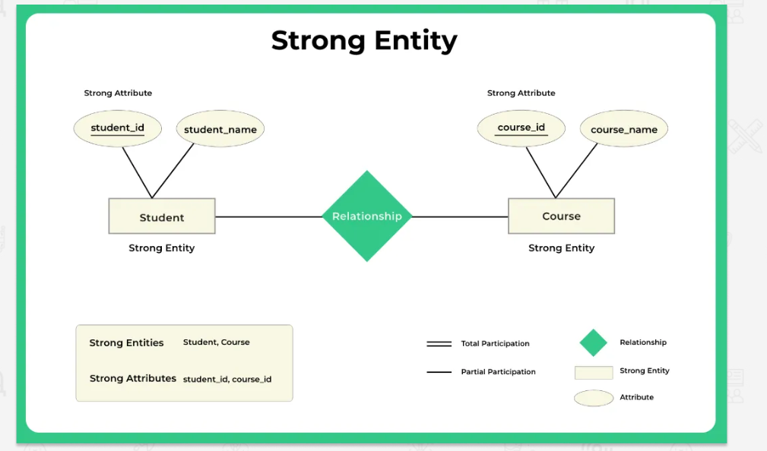

Slide 14
Weak entity
A weak entity is an entity set that does not have sufficient attributes for Unique Identification of its records.
Example 1 – A loan entity can not be created for a customer if the customer doesn’t exist
Example 2 – A dependents list entity can not be created if the employee doesn’t exist
Simply a weak entity is nothing but an entity that does not have a primary key attribute
It contains a partial key called a discriminator which helps in identifying a group of entities from the entity set
A discriminator is represented by underlining with a dashed line
Representation
  A double rectangle is used for representing a weak entity set
  The double diamond symbol is used for representing the relationship between a strong entity and a weak entity which is known as identifying relationship

Slide 15
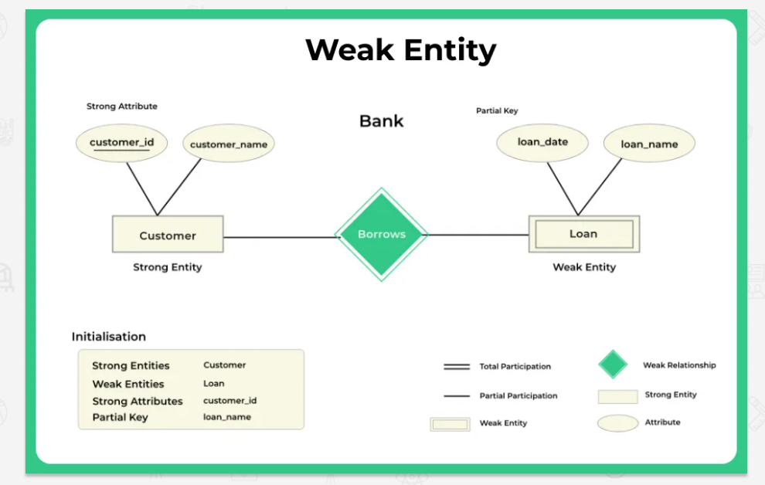

Slide 16
Strong entity | Weak entity
Strong entity always has a primary key. | It will not have a primary key but it has partial discriminator key.
It is not dependent on any other entity. | Weak entity is dependent on the strong entity.
Represented by a single rectangle. | Represented by double rectangle.
Relationship between two strong entities is represented by a single diamond. | Relationship between a strong entity and the weak entity is represented by double Diamond.
A strong entity may or may not have total participation. | It has always total participation.

Slide 17
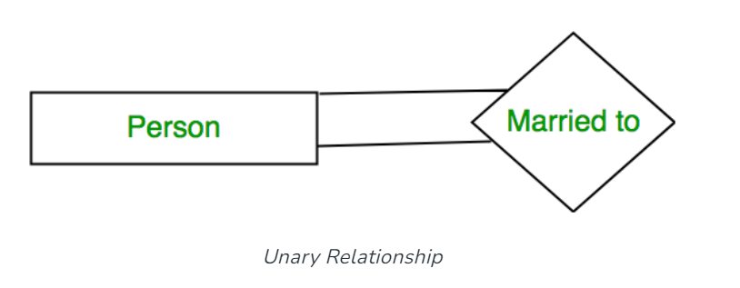
Degree of a Relationship Set
Unary Relationship:

Slide 18
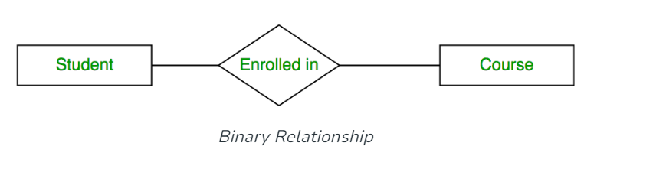
Binary Relationship:

Slide 19
n-ary Relationship: When there are n entities set participating in a relation, the relationship is called an n-ary relationship.

Slide 20
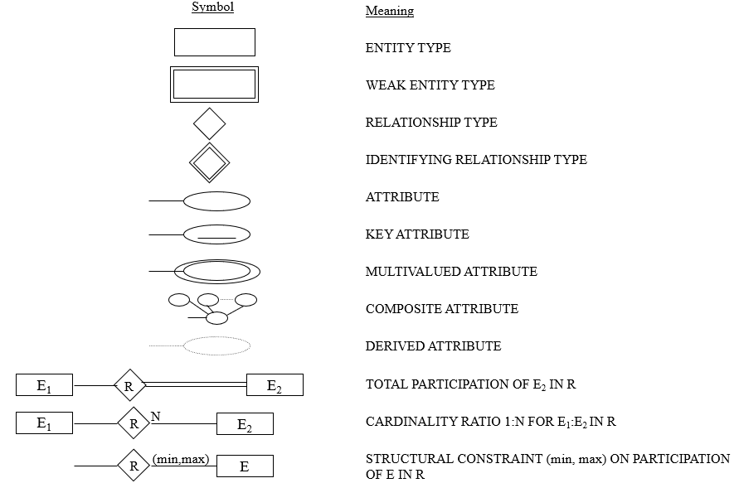
SUMMARY OF ER-DIAGRAM
NOTATION FOR ER SCHEMAS

Slide 21
How to draw ER Diagram
Step 1: Identify the entities .
Step 2: Identify the attributes (properties of entities).
Step 3: Identify the relationships (how entities are connected).
Step 4: Assign cardinality (one-to-one, one-to-many, or many-to-many).
Step 5: Draw the diagram using rectangles, ovals, and diamonds.

Slide 22
Example Questions
Q)Library Management System
Each book has a title, author, and ISBN number.
Each Student has Name, Roll no, Address
Students can borrow books, and each borrowing record includes the issue date and return date.
A student can borrow multiple books, but each book can be borrowed by only one student at a time.
Q) Hospital Database
A hospital has doctors and patients.
Each doctor has a doctor ID, name, and specialization.
Each patient has a patient ID, name, and disease.
A doctor can treat multiple patients, and a patient can be treated by multiple doctors.

Slide 23
Q) Online Shopping System
Customers can place orders for different products.
Each product has a product ID, name, price, and stock quantity.
Each order has an order ID, order date, and total amount.
A customer can place multiple orders, but an order is linked to only one customer.
Each order can contain multiple products, and each product can appear in multiple orders.
Q) University Database
A university has departments.
Each department has multiple professors.
A professor teaches multiple courses, and each course can be taught by multiple professors.
Each student enrolls in multiple courses, and a course can have multiple students.

Slide 24
Q)Hotel Booking System
A hotel has rooms, and each room has a room number, room type, and price.
A customer can make reservations for a room.
A reservation includes check-in date, check-out date, and payment details.
A customer can book multiple rooms, but a room can only be booked by one customer at a time.
Q) Banking System
A bank has multiple branches.
Each branch has employees and customers.
A customer can have multiple accounts, and an account can belong to only one customer.
Each account has a balance, account type, and account number.
Customers can perform transactions like withdrawals and deposits.

Slide 25
Example: COMPANY Database
Requirements of the Company
  The company is organized into DEPARTMENTs. Each department has a name, number and an employee who manages the department. We keep track of the start date of the department manager.
  Each department controls a number of PROJECTs. Each project has a name, number and is located at a single location.

Slide 26
We store each EMPLOYEE’s social security number, address, salary, sex, and birthdate.
Each employee works for one department but may work on several projects. We keep track of the number of hours per week that an employee currently works on each project. We also keep track of the direct supervisor of each employee.
Each employee may have a number of DEPENDENTs. For each dependent, we keep track of their name, sex, birthdate, and relationship to employee.

Slide 27
ER Model Concepts
Entities and Attributes
  Entities are specific objects or things in the mini-world that are represented in the database. For example the EMPLOYEE John Smith, the Research DEPARTMENT, the ProductX PROJECT
  Attributes are properties used to describe an entity. For example an EMPLOYEE entity may have a Name, SSN, Address, Sex, BirthDate
  A specific entity will have a value for each of its attributes. For example a specific employee entity may have Name='John Smith', SSN='123456789', Address ='731, Fondren, Houston, TX', Sex='M', BirthDate='09-JAN-55‘
  Each attribute has a value set (or data type) associated with it – e.g. integer, string, subrange, enumerated type, …

Slide 28
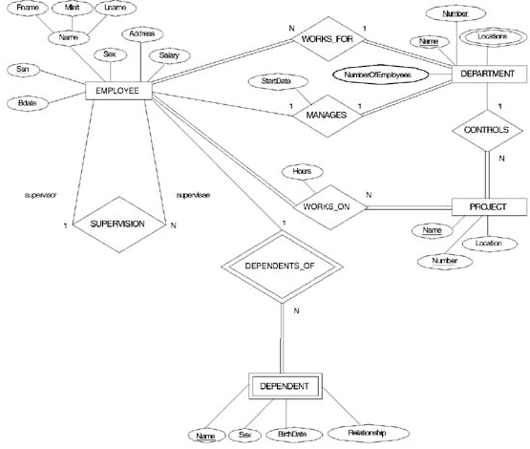
ER DIAGRAM – Entity Types are:
EMPLOYEE, DEPARTMENT, PROJECT, DEPENDENT

Slide 29
Relationships and Relationship Types
A relationship relates two or more distinct entities with a specific meaning. For example, EMPLOYEE John Smith works on the ProductX PROJECT or EMPLOYEE Franklin Wong manages the Research DEPARTMENT.
Relationships of the same type are grouped or typed into a relationship type. For example, the WORKS_ON relationship type in which EMPLOYEEs and PROJECTs participate, or the MANAGES relationship type in which EMPLOYEEs and DEPARTMENTs participate.
The degree of a relationship type is the number of participating entity types. Both MANAGES and WORKS_ON are binary relationships.

Slide 30
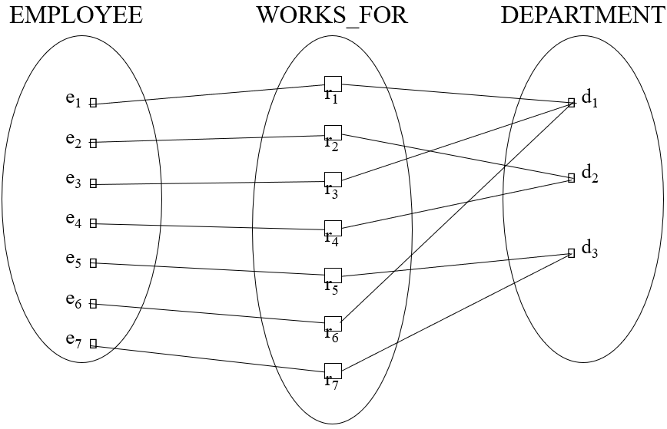
Example: relationship instances of the WORKS_FOR relationship between EMPLOYEE and DEPARTMENT

Slide 31
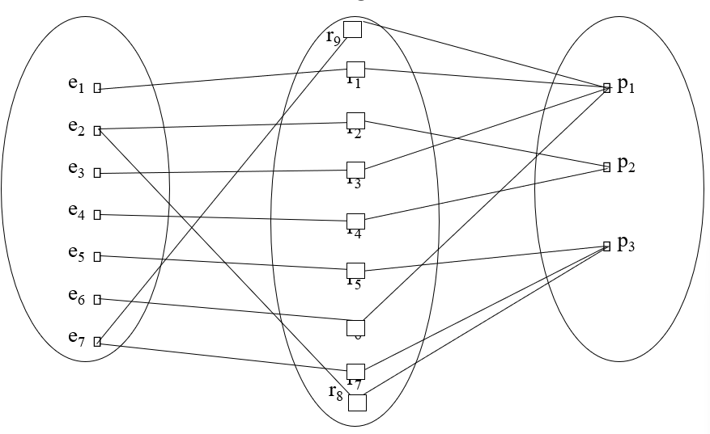
Example relationship instances of the WORKS_ON relationship between EMPLOYEE and PROJECT

Slide 32
Participation constraints
There are two types of participation constraints in database management systems, such as :
  Total Participation
  Partial Participation

Slide 33
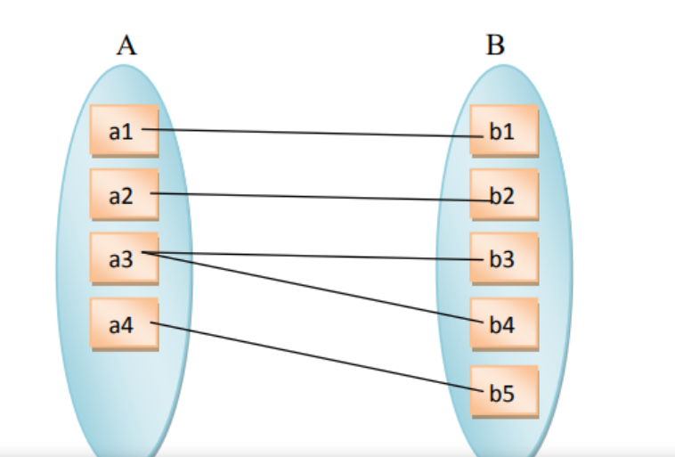
Total participation
The participation of entity set A in the relationship set is total if every entity in A participates in at least one relationship in R and The participation of entity set B in the relationship set is also total because every entity of B also participates in the relationship set.

Slide 34
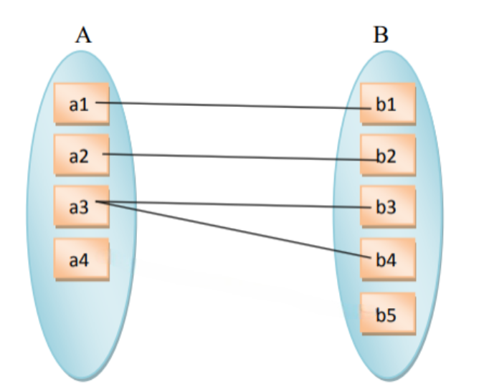
Partial participation
The participation of an entity set E in relationship set R is said to be partial if only some entities in E participate in relationships in R.
The participation of entity set A in the relationship set is partial because only some entities of A participate in the relationship set.

Slide 35
Relationships and Relationship Types
More than one relationship type can exist with the same participating entity types. For example, MANAGES and WORKS_FOR are distinct relationships between EMPLOYEE and DEPARTMENT, but with different meanings and different relationship instances.

Slide 36
ER DIAGRAM – Relationship Types are:
WORKS_FOR, MANAGES, WORKS_ON, CONTROLS,
SUPERVISION, DEPENDENTS_OF

Slide 37
Entity Types and Key Attributes
Entities with the same basic attributes are grouped or typed into an entity type. For example, the EMPLOYEE entity type or the PROJECT entity type.
An attribute of an entity type for which each entity must have a unique value is called a key attribute of the entity type. For example, SSN of EMPLOYEE.
A key attribute may be composite. For example, VehicleTagNumber is a key of the CAR entity type with components (Number, State).
An entity type may have more than one key. For example, the CAR entity type may have two keys:
  VehicleIdentificationNumber (popularly called VIN) and
  VehicleTagNumber (Number, State), also known as license_plate number.

Slide 38
Integrity Constraints
Integrity constraints are a set of rules. It is used to maintain the quality of information.
Integrity constraints ensure that the data insertion, updating, and other processes have to be performed in such a way that data integrity is not affected.
Thus, integrity constraint is used to guard against accidental damage to the database

Slide 39
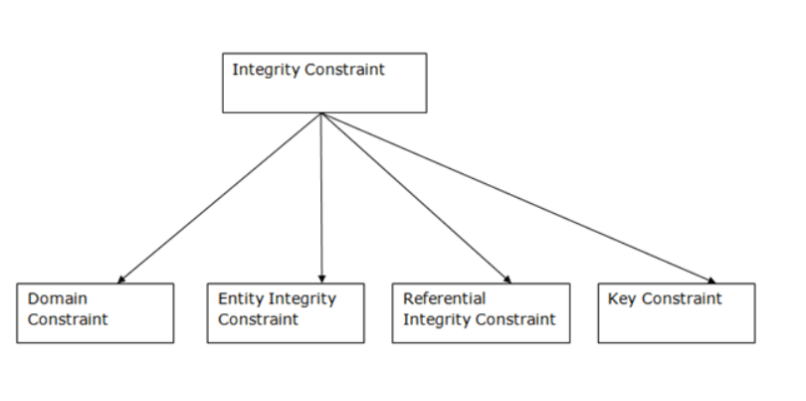
Types of Integrity Constraint

Slide 40
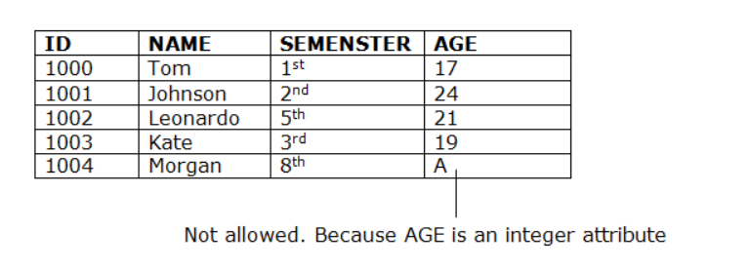
Domain constraints
Domain constraints can be defined as the definition of a valid set of values for an attribute.
The data type of domain includes string, character, integer, time, date, currency, etc. The value of the attribute must be available in the corresponding domain.

Slide 41
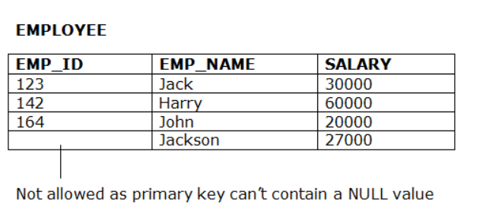
Entity integrity constraints
The entity integrity constraint states that primary key value can't be null.
This is because the primary key value is used to identify individual rows in relation and if the primary key has a null value, then we can't identify those rows.
A table can contain a null value other than the primary key field.

Slide 42
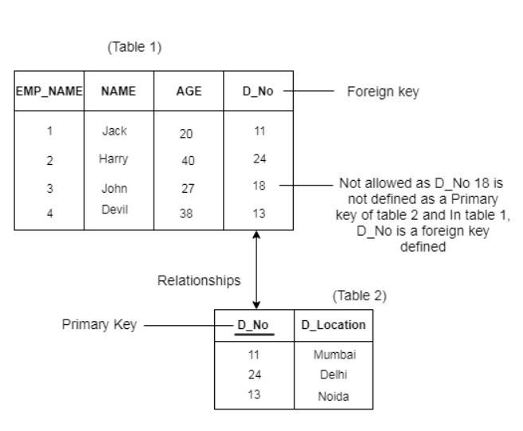
Referential Integrity Constraints
A referential integrity constraint is specified between two tables.
In the Referential integrity constraints, if a foreign key in Table 1 refers to the Primary Key of Table 2, then every value of the Foreign Key in Table 1 must be null or be available in Table 2

Slide 43
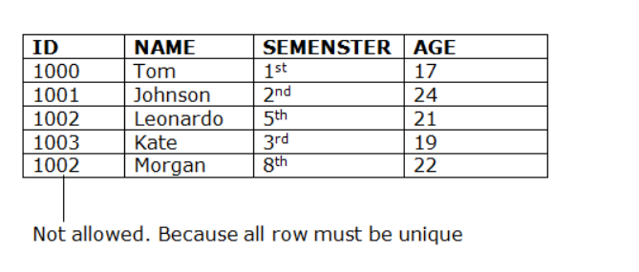
Key constraints
Keys are the entity set that is used to identify an entity within its entity set uniquely.
An entity set can have multiple keys, but out of which one key will be the primary key. A primary key can contain a unique and null value in the relational table.

Slide 44
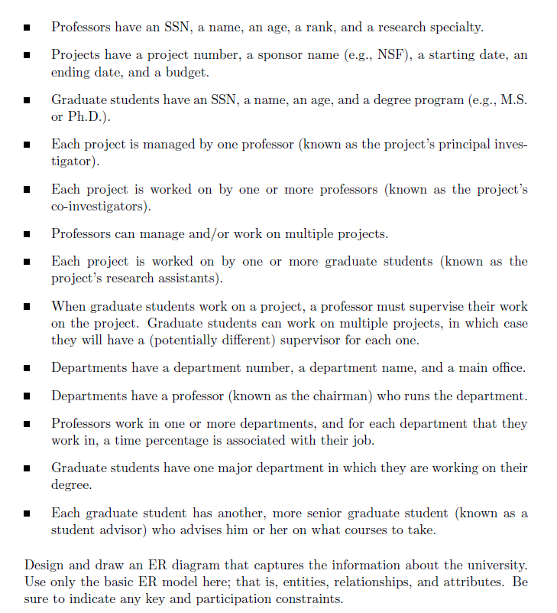

Slide 45
Extended ER
Extended ER is a high-level data model that incorporates the extensions to the original ER model. Enhanced ER models are high level models that represent the requirements and complexities of complex databases.
The extended Entity Relationship (ER) models are three types as given below −
Aggregation
Specialization
Generalization

Slide 46
Specialization
The process of designing sub groupings within an entity set is called specialization.
It is a top-down process.
If an entity set is given with all the attributes in which the instances of the entity set are differentiated according to the given attribute value, then that sub-classes or the sub-entity sets can be formed from the given attribute.
Example
Specialization of a person allows us to distinguish a person according to whether they are employees or customers.
Specialization of account creates two entity sets: savings account and current account.

Slide 47
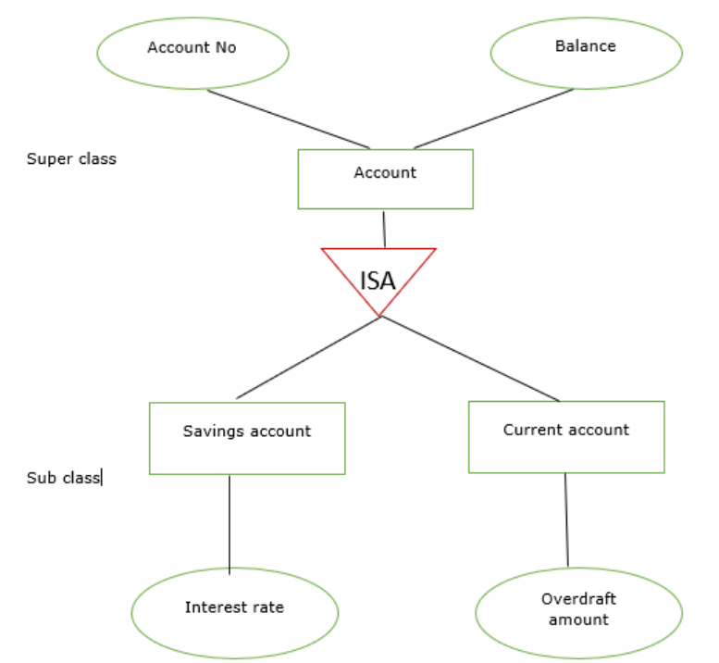
In the E-R diagram specialization is represented by triangle components labeled ISA.
The ISA relationship is referred as superclass- subclass relationship as shown below −

Slide 48
Generalization
it is the reverse process of specialization.
It is a bottom-up approach.
It converts subclasses to superclasses.
This process combines a number of entity sets that share the same features into higher-level entity sets.
If the sub-class information is given for the given entity set then, ISA relationship type will be used to represent the connectivity between the subclass and superclass as shown below −

Slide 49
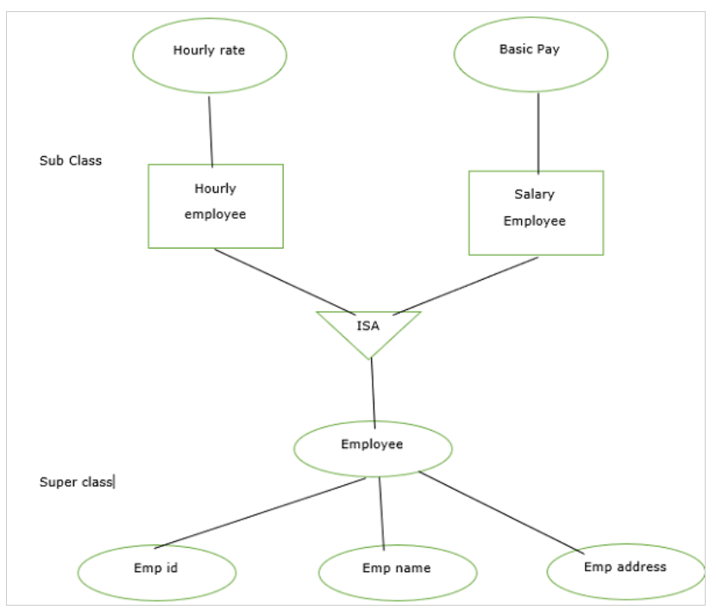

Slide 50
Aggregation
In aggregation, the relation between two entities is treated as a single entity. In aggregation, relationship with its corresponding entities is aggregated into a higher level entity.
For example: Center entity offers the Course entity act as a single entity in the relationship which is in a relationship with another entity visitor. In the real world, if a visitor visits a coaching center then he will never enquiry about the Course only or just about the Center instead he will ask the enquiry about both.

Slide 51
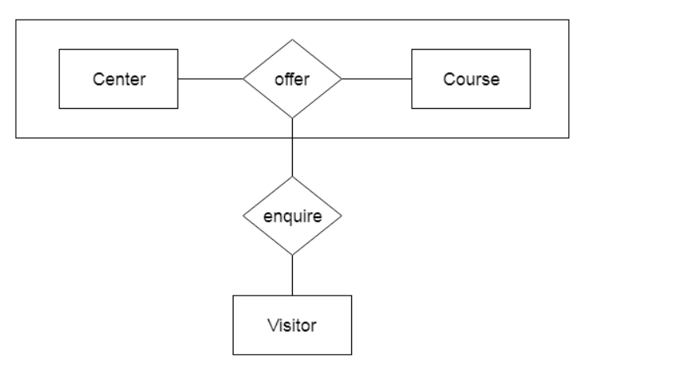

Slide 52
Structural Constraints – one way to express semantics of relationships
Structural constraints on relationships:
Cardinality ratio (of a binary relationship): 1:1, 1:N, N:1, or M:N
  SHOWN BY PLACING APPROPRIATE NUMBER ON THE LINK.
Participation constraint (on each participating entity type): total (called existence dependency) or partial.
SHOWN BY DOUBLE LINING THE LINK
NOTE: These are easy to specify for Binary Relationship Types.

Slide 53
Alternative (min, max) notation for relationship structural constraints:
Specified on each participation of an entity type E in a relationship type R
Specifies that each entity e in E participates in at least min and at most max relationship instances in R
Default(no constraint): min=0, max=n
Must have min≤max, min≥0, max ≥1
Derived from the knowledge of mini-world constraints
Examples:
A department has exactly one manager and an employee can manage at most one department.
  Specify (0,1) for participation of EMPLOYEE in MANAGES
  Specify (1,1) for participation of DEPARTMENT in MANAGES
An employee can work for exactly one department but a department can have any number of employees.
  Specify (1,1) for participation of EMPLOYEE in WORKS_FOR
  Specify (0,n) for participation of DEPARTMENT in WORKS_FOR

Slide 54
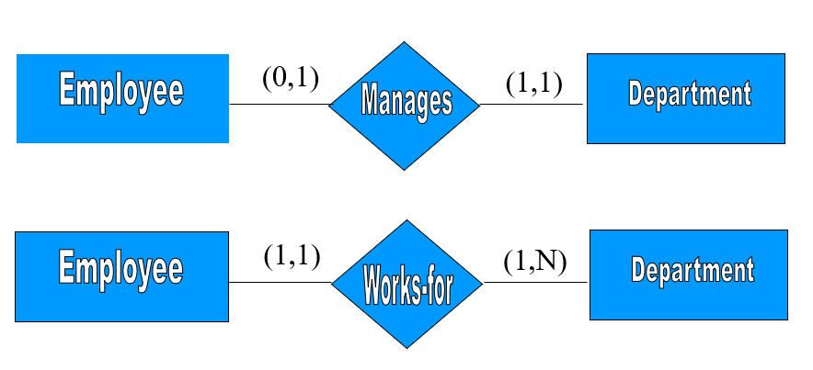
The (min,max) notation relationship constraints

Slide 55
Example
Student - Hostel Room Assignment
Student (Strong Entity):Student_ID (Primary Key)Name,Age
Room (Weak Entity):Room_Number (Partial Key)
Lives_In (Relationship)

Slide 56
Example 2:Online Shopping System
Customer( Customer_ID (PK) , Name ,Email ,Address)
Product(Product_ID (PK) ,Name ,Price ,Category )
Order (Weak Entity)(Order_ID (Partial key) ,Customer_ID (FK) ,Order_Date ,Total_Amount )
Order_Details (Associative Entity for M:N Relationship)(Order_ID (FK) ,Product_ID (FK) ,Quantity ,Subtotal )
Relationships
Customer places Orders (1:M)
Order contains multiple Products (M:N → Resolved via Order_Details)

